Slide 1

Text mining of companies annual reports in PDF format
José Miguel soares | Banco de portugal
56th World Continuous Auditing and
Reporting Symposium (WCARS)
Banco de España – april 27 & 28, 2023

Slide 2
OUTLINE
01
  motivation
02
  framework
03
  methodology
  04
  Results and way forward

Slide 3
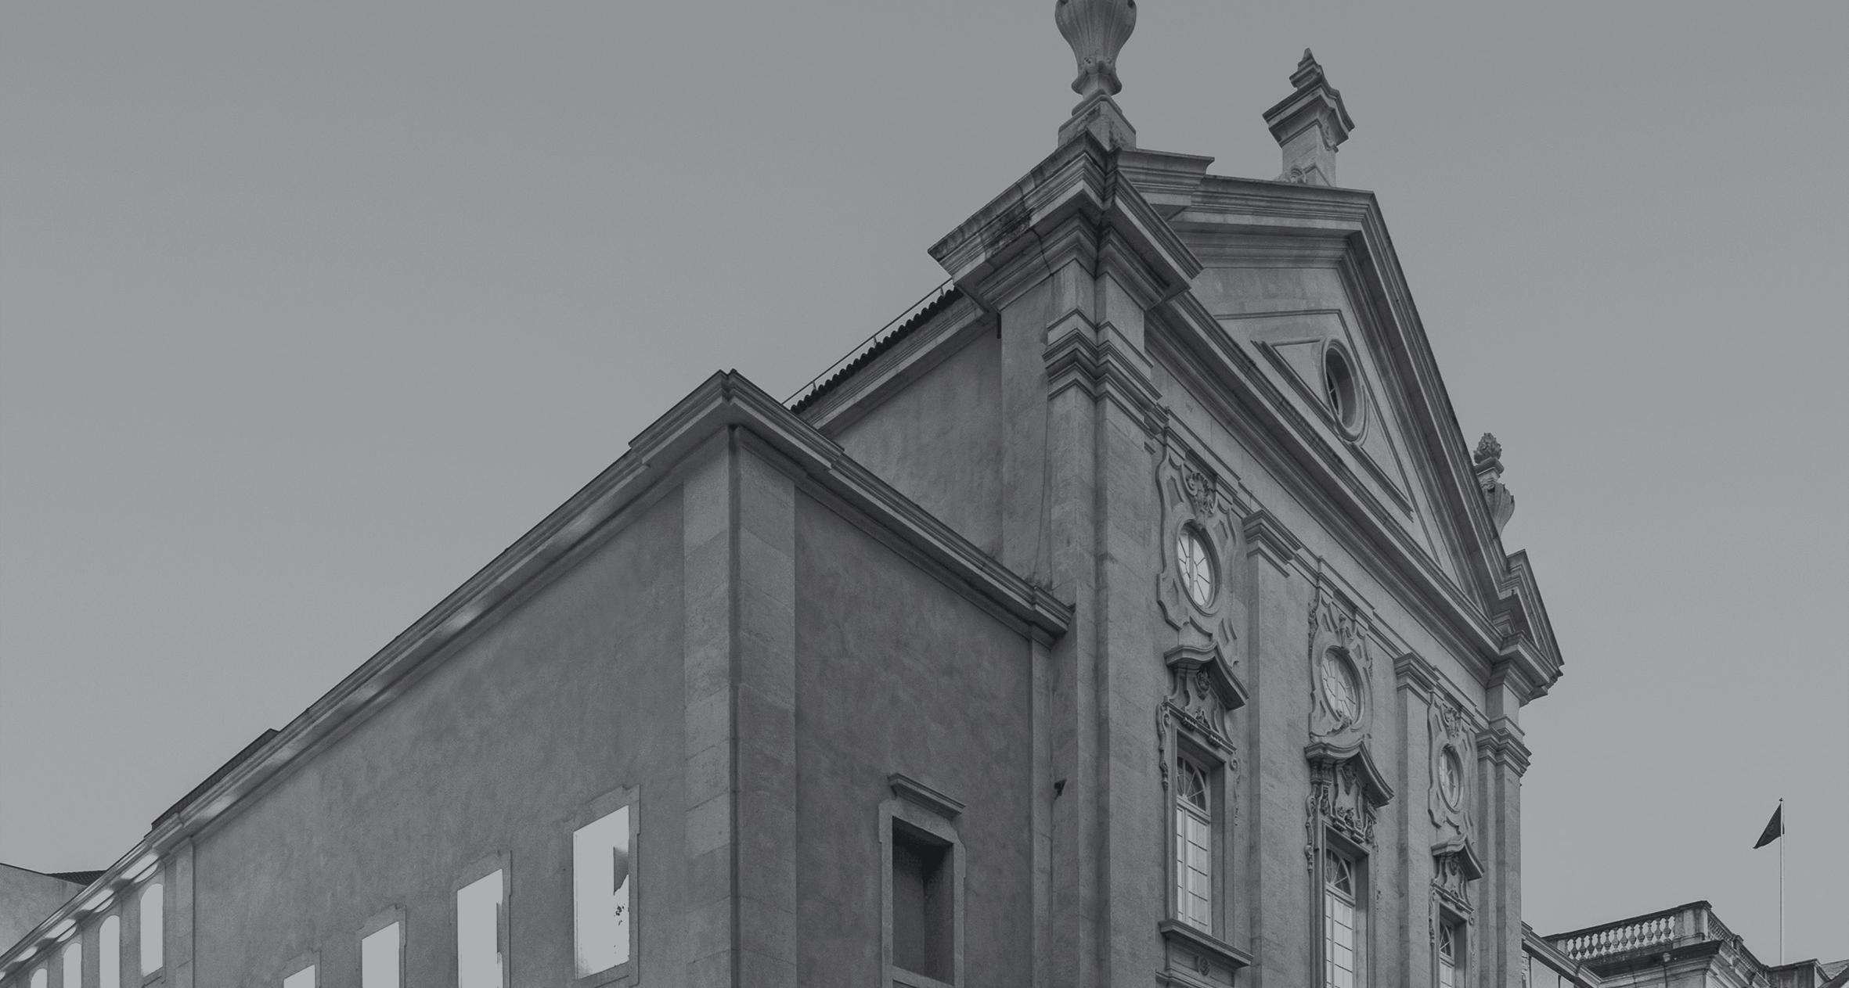
motivation
01

Slide 4
01. motivation
  The Central Balance Sheet Database of Banco de Portugal is an economic and financial database on Portuguese non-financial corporations. It contains information used for economic and financial research.
  Through the Central Balance Sheet Database, Banco de Portugal provides corporations with useful information for management and for a better perception of their position within their branch of economic activity.
  The Central Balance Sheet Database provides Banco de Portugal with useful data for carrying out its tasks, namely in terms of statistics, financial stability analysis and research on the Portuguese economy.

Slide 5
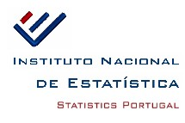





01. motivation
Quarterly data
ITENF – Quarterly survey to non-financial corporations
Firms
Anual data
IES – Simplified corporate information

Slide 6




01. motivation
Manual upload of consolidated financial information.
Semi-automatic extraction of information from PDFs.

Slide 7
framework
02

Slide 8
02. framework
  Text mining methods aim to extract relevant information from documents in PDF format.
  Through the exploration of the PDF files, the mail goal is applying different text mining techniques that allow the identification and extraction of relevant data.
SAMPLE: Consolidated annual reports for listed groups or available at companies websites
DATA: Financial statements in annual reports in a PDF format
GOAL:
The algorithm should be able to: 1) identify which pages of the Financial Statements contain the Income Statement and the Statement of Financial Position; and 2) extract these data.

Slide 9





02. framework
  One of the importante aspects of the qualitative implementation of the model is the choice of the optimal software and also…

Slide 10
02. framework
  One of the importante aspects of the qualitative implementation of the model is the choice of the optimal software and also…

Slide 11

02. framework
  … the software environment.
csv
tabula
numpy
pandas
tabulate
PyPDF2
pytesseract
camelot

Slide 12
methodology
03

Slide 13
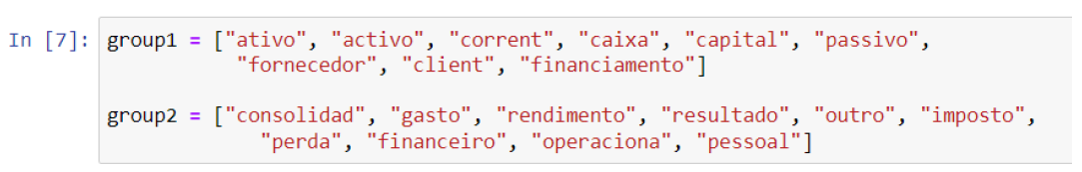
Analyst approach
03. METHODOLOGY
  In the first stage, analysts identify the most frequently occurring words in Financial statements.
  The words provided were divided into 2 main groups, which represent two main statements: Group 1 - Statement of Financial Position and Group 2 - Income statement.
  The following code provides the results in a DataFrame with division into groups. The total number of pages that meet the defined criteria for each each group is displayed. The last column shows the number of correct pages identified.

Slide 14
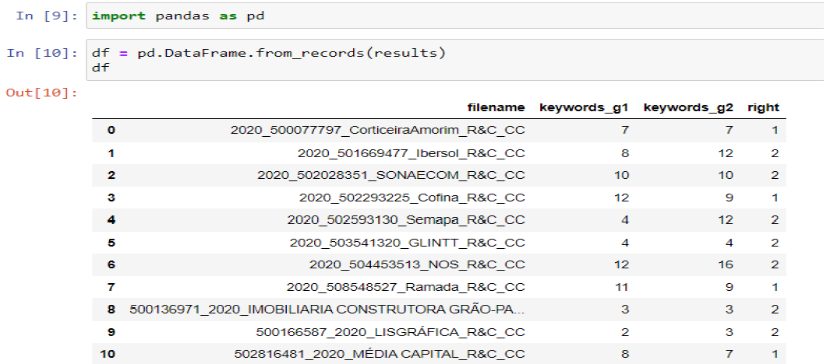
Analyst approach
03. METHODOLOGY

Slide 15
Machine learning approach
03. METHODOLOGY
  Instead of using words provided in the 1st approach we use the HAM 12 code (learning from reporting of the 12 companies).
  Given the results obtained and the degree of similarity with accounting terminology, we performed some changes (drop and include words) in the selection:
  In Group 1, the word "consolida" was added and the word "passivar" was excluded; in Group 2, the words "imposto , atribuivel, outro" were added, and the words "externo" , fornecimento, sobrar, antar" were excluded.

Slide 16
Stemming & lemmatization
03. METHODOLOGY
Identify the basic form of words
Example:
FIRM A:
Outras contas a pagar
Outro conto pagar
FIRM B:
Outros passivos
Outro passivo
We use spacy for lemmatization, bringing words back to their basic form.

Slide 17
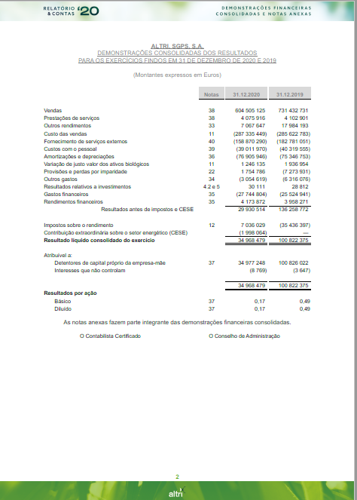
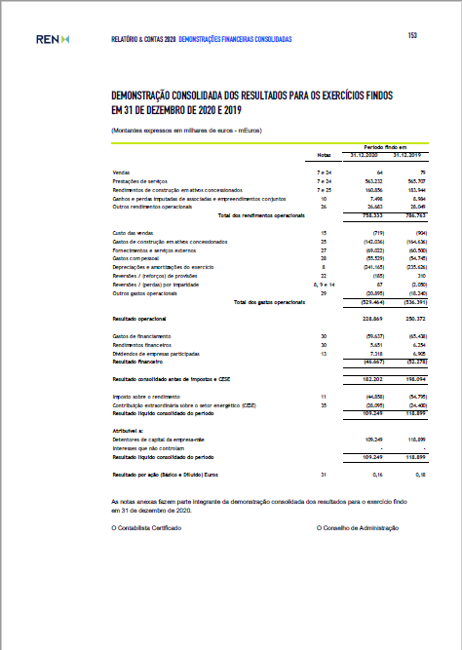
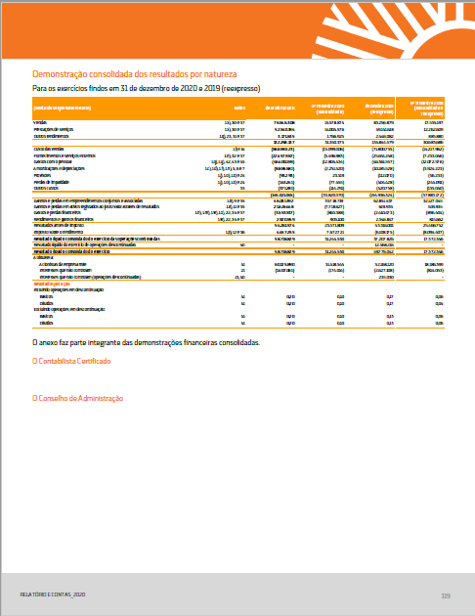
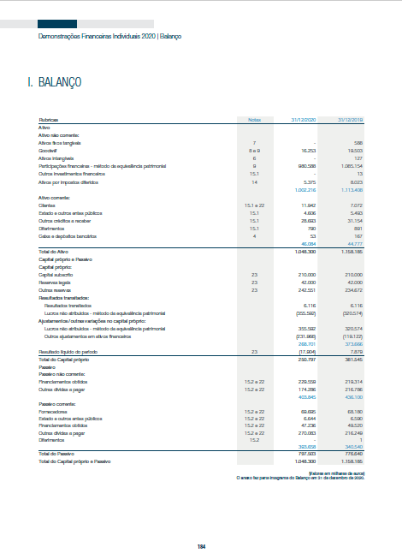
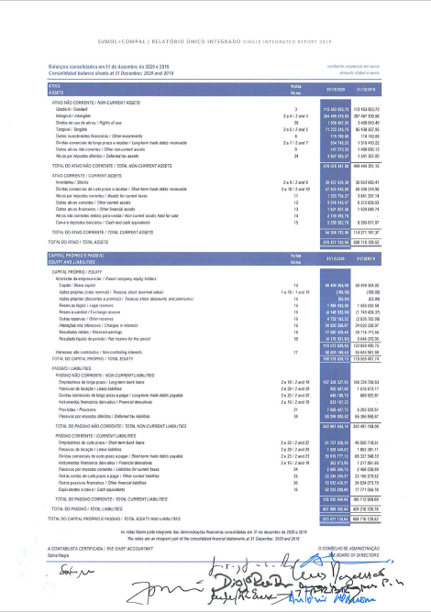
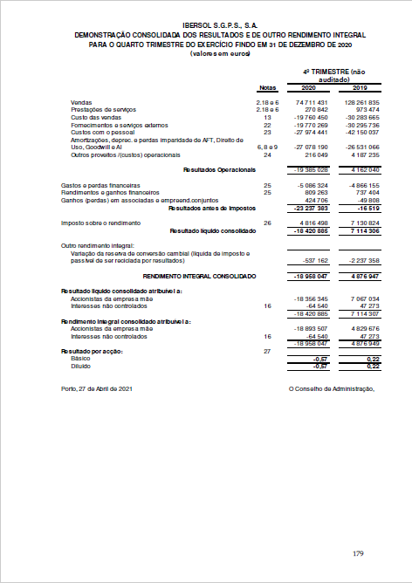
numeric characters
03. METHODOLOGY
All numeric characters in the range (1, 10) are replaced by “0”.
The algorithm looks for pages with “00”.

Slide 18
AtTributEs
03. METHODOLOGY
STATEMENT OF FINANCIAL POSITION
INCOME STATEMENT
ACTIVO
ATIVO
PASSIVO
GASTO
FINANCEIRO
PERDA
FORNECEDOR
CAIXA
CORRENTE
OPERACIONA
PESSOAL
RENDIMENTO
Words suggested by the analysts – 1st approach
FINANCIAMENTO
CLIENTE
CAPITAL
IMPOSTO
OUTRO
RESULTADO
CONSOLIDA
CONSOLIDA
EURO
FIXO
RESERVA
EURO
SERVIÇO
RESERVA
Words identified by machine learning model
PROVISÃO
TOTAL
PRÓPRIO
NOTA
IMPARIDADE
ATRIBUÍVEL
RESULTADO
DIFERIMENTO
OUTRO
DEMONSTRAÇÃO
00
00
Numerical characters

Slide 19
DATA MINING
03. METHODOLOGY
01
For each page, the algorithm computs how many attributes are identified.
02
The page that includes more attributes/words is selected.
Each atribute is only counted once.
When there are two or more pages with the same number of attributes, the algorithm extracts both pages.
04
The algorithm saves the outputs in a given directory.
03
Notes:
19

Slide 20
Conclusions and way forward
04

Slide 21
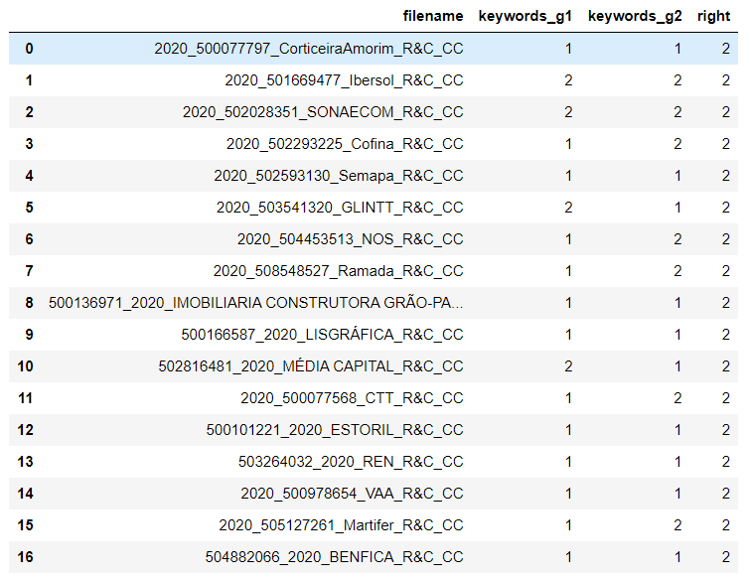
04. Results and way forward
  Our primary goal (to identify which pages of the report contain the Income Statement and the Statement of Financial Position and extract this information) was successfully concluded.

Slide 22
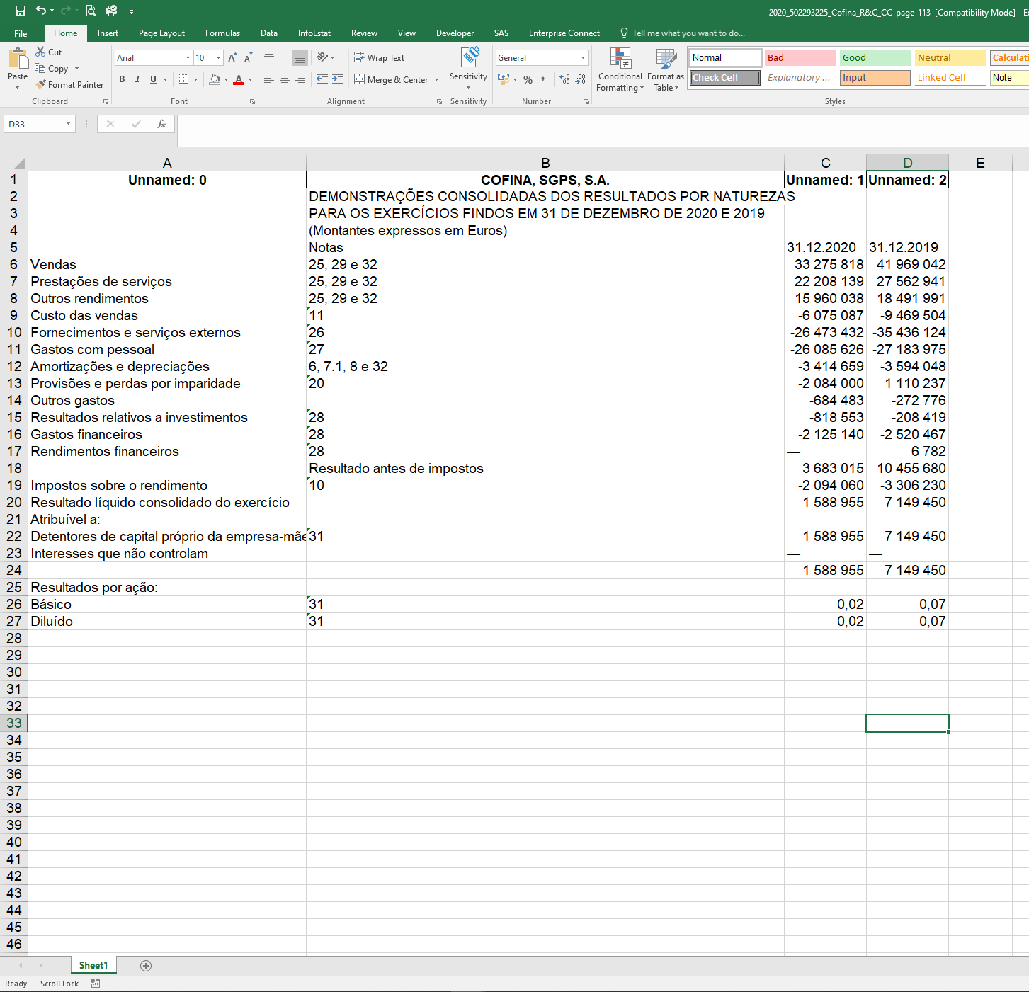
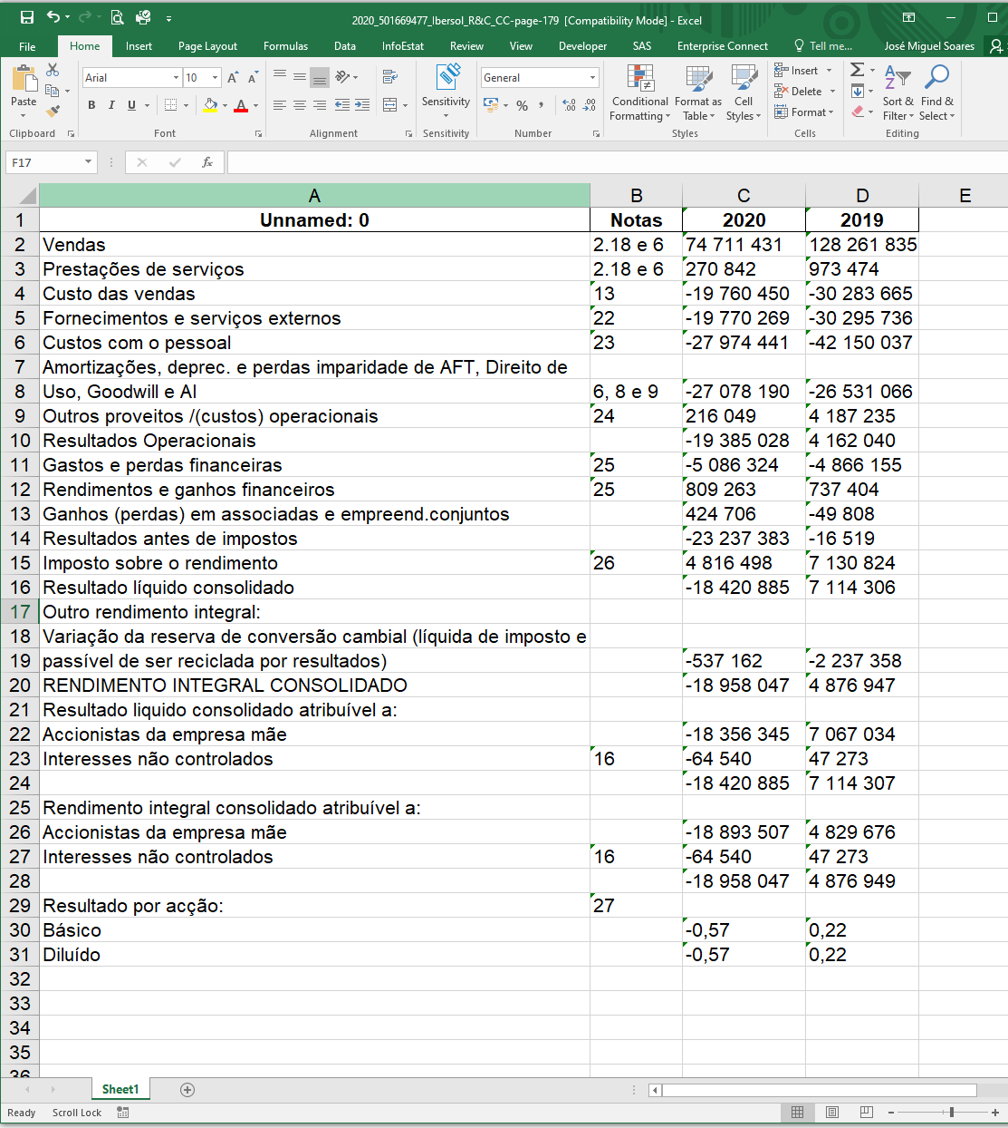
04. Results and way forward
  However, this is an intermediate step to another purpose, which is to use that information to fill in the file used to upload the information to the Central Balance Sheet Database .

Slide 23
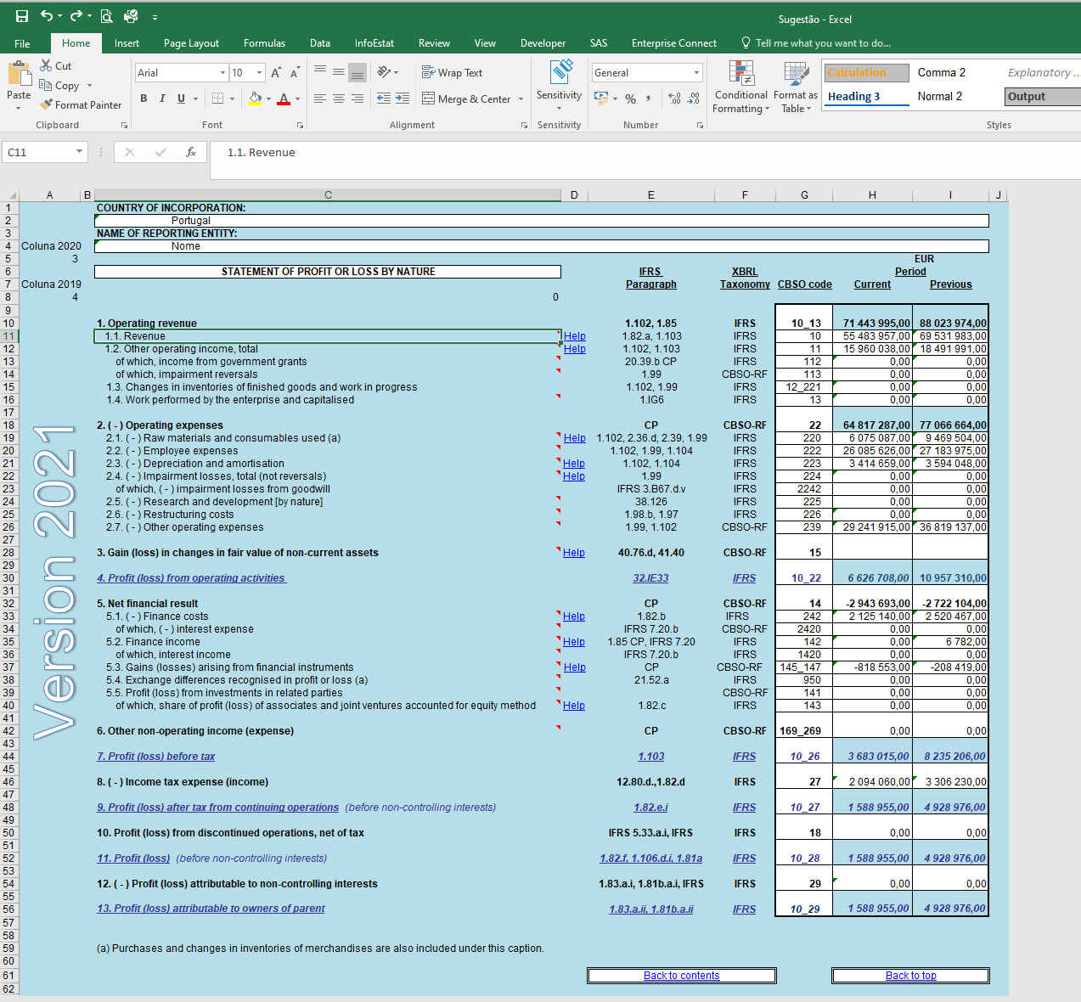
04. Results and way forward

Slide 24
04. Results and way forward
Semi-automatic Fill of the IFRS Consolidated accounts format
ADVANTAGES
WAY FORWARD
Lower need for resources (time, trainees, etc.
Lower manual and repetitive work.
Take into account the detail of the notes in the annex to the financial statements for mapping purposes.
Using the extracted files to semi-automatic fill the IFRS Consolidated Accounts format

Slide 25

Thank you

